Slide 1

What is glitch
A glitch is a short-lived fault in a system, such as a transient fault that corrects itself, making it difficult to troubleshoot. The term is particularly common in the computing and electronics industries, in circuit bending, as well as among players of video games. More generally, all types of systems including human organizations and nature experience glitches.

Slide 2
Electronics glitch & Timing Hazards
General define : that occurs on a signal before the signal settles to its intended value, particularly in a digital circuit.
Do to timing delays, the transient behavior of a logic circuit
may differ from what is predicted by a steady-state analysis.
A circuit’s output may produce a glitch at a time when
steady-state analysis predicted that the output should not
change. A hazard exist when a circuit has the possibility of
producing a glitch.

Slide 3

Types of Hazards
* Static – 1 Hazard
* Static – 0 Hazard
* Dynamic Hazard
* - Static – 1 Hazard :
A static-1 hazard is a pair of input combinations that : (a)
differ in only one input variable and (b) both give a give a
1 output; such that it is possible for a momentary 0 output
to occur during a transition in the differing input variable

Slide 4


* Static – 0 Hazard : A static-0 hazard is a pair of input combinations that : (a) differ in only one input variable and (b) both give a give a 0 output; such that it is possible for a momentary 1 output to occur during a transition in the differing input variable * Dynamic Hazard : A dynamic hazard is the possibility of an output changing more than once as the result of a single input transition. A dynamic hazard can occur if there are multiple paths with different delays from the changing input to the changing output

Slide 5
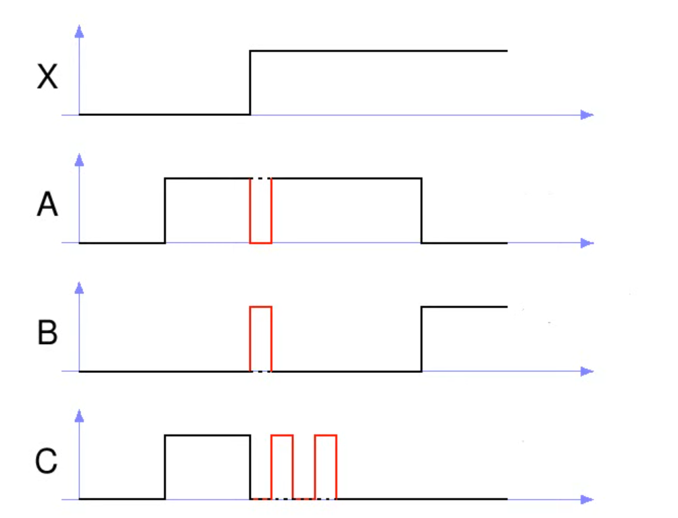
more details about timing hazard
Normal
Static 1 hazard
Static 0 hazard
Dynamic hazard

Slide 6
References
1- https://www.youtube.com/watch?v=HHq86gQ35Zs
2 - https://en.wikipedia.org/wiki/Glitch

